Slide 1
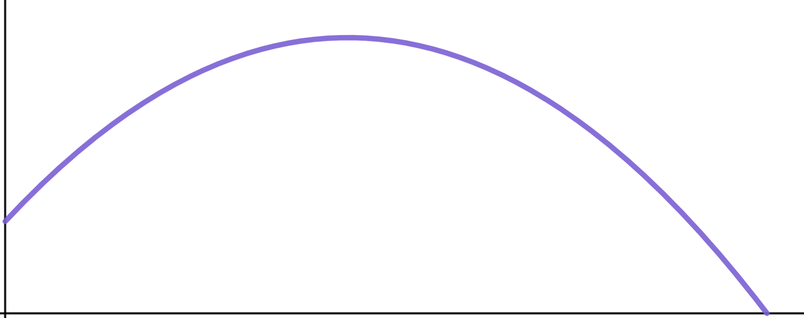

Problem solving with graphical representations
Task A: Using sketches to locate intersections
1) Sketch two lines for each equation to decide if the solution is positive or negative. Don’t forget to label key features like the y-intercept.
a) 15 − 9x = 6x + 31
b) 9 − 15x = 6x − 31
2) What equations does this sketch help us to solve and what can we see about the solution?
Write at least two sentences.
y
5y − 3x = 15
✖
(0, 3)
✖
✖
(0, −3)
x
(0,−5)
(0,−2)
✖
3) Draw appropriate lines on this graph and identify intersections to answer these questions about Laura’s improving cricket throw.
2x + 3y = −6
a) How many times was the ball at a height of 5 m ?
h
✖
(20, 10)
b) How many times was the ball at a height of 1 m ?
✖
(0, 1.5)
(45, 0)
✖
c) How many times was the ball at a height of 10 m ?
d

Slide 2
Problem solving with graphical representations
Task B: Matching sketches to real-life models
1) Use these blank axes to draw three race events.
a) A short distance, fast race run at a constant speed.
distance
b) A middle distance, medium pace race run at a constant speed.
c) A long distance, slow run at a constant speed.
time
2) This graph shows two animals running.
One is a human, one is a cheetah.
Identify which line represents which and explain how you know?
Point to more than one key moment in the graph to support your explanation.
distance
time
Mathematics in Education and Industry
v2.3

